Slide 1
Inheritance and Polymorphism
Department of Computer Science,
National University of Computer & Emerging Sciences, Islamabad Campus

Slide 2
contents
What Is Inheritance?, Protected Members and Class Access, Constructors and Destructors in Base and Derived Classes, Redefining Base Class Functions, Class Hierarchies, Polymorphism and Virtual Member Functions, Abstract Base Classes and Pure Virtual Functions, Multiple Inheritance
8 Lectures (1 Hour /lec)

Slide 3
Part 1

Slide 4
Inheritance
Probably most powerful feature of OOP
Concept similar to inheritance in real life
New classes are created from existing classes

Slide 5
Introduction - Inheritance
New classes absorb all features of existing classes including their data and functions.
Also enhance them by adding their own new features in form of new data members and new member functions

Slide 6
Is-A vs Has-A relationship
Has-A relationship is composition type of relationship (i.e., whole-part relationship)
Car has an engine
Is-A relationship: also called association
Car is vehicle
Student is person
Implementation:
Composition: making member
Association: using inheritance

Slide 7
Introduction - Inheritance
Existing classes are called base classes
New classes are called derived classes
Objects of derived classes are more specialized as compared to objects of their base classes
Inheritance provides us a mechanism of software reusability which is one of the most important principles of software engineering

Slide 8
Inheriting Data and Functions
All data members and member functions of base class are inherited to derived class
Constructors, destructors and = operator are not inherited

Slide 9
Some definitions in class hierarchy
Direct base class
Inherited explicitly (one level up hierarchy)
Indirect base class
Inherited two or more levels up hierarchy
Single inheritance
Inherits from one base class
Multiple inheritance
Inheritance from multiple classes

Slide 10
Animals: Class’s hierarchy
Classification
Animal
Mammal
Reptiles
People
Dog
. . . . .
man
woman
Inheritance
John
Mary

Slide 11
Inheritance Examples

Slide 12
Another example: University’s community member’s hierarchy
CommunityMember
Employee
Student
Alumnus
Single inheritance
Faculty
Staff
Single inheritance
Administrator
Teacher
Single inheritance
AdministratorTeacher
Multiple inheritance

Slide 13
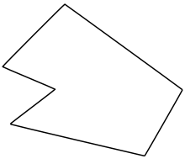
Inheritance Concept
class Rectangle{
private:
int numVertices;
float *xCoord, *yCoord;
public:
void set(float *x, float *y, int nV);
float area();
};
Polygon
Rectangle
Triangle
class Polygon{
private:
int numVertices;
float *xCoord, *yCoord;
public:
void set(float *x, float *y, int nV);
};
class Triangle{
private:
int numVertices;
float *xCoord, *yCoord;
public:
void set(float *x, float *y, int nV);
float area();
};

Slide 14
Inheritance Concept
Polygon
class Polygon{
protected:
int numVertices;
float *xCoord, float *yCoord;
public:
void set(float *x, float *y, int nV);
};
Triangle
Rectangle
class Rectangle : public Polygon{
public:
float area();
};
class Rectangle{
protected:
int numVertices;
float *xCoord, float *yCoord;
public:
void set(float *x, float *y, int nV);
float area();
};

Slide 15
Inheritance Concept
class Polygon{
protected:
int numVertices;
float *xCoord, float *yCoord;
public:
void set(float *x, float *y, int nV);
};
Polygon
Rectangle
Triangle
class Triangle{
protected:
int numVertices;
float *xCoord, float *yCoord;
public:
void set(float *x, float *y, int nV);
float area();
};
class Triangle : public Polygon{
public:
float area();
};

Slide 16
Inheritance Concept
Point
x
y
class Point{
protected:
int x, y;
public:
void set (int a, int b);
};
Circle
3D-Point
x
y
r
x
y
z
class Circle : public Point{
private:
double r;
};
class 3D-Point: public Point{
private:
int z;
};

Slide 17
Define a Class Hierarchy
Syntax:
class DerivedClassName : access-level BaseClassName
where
access-level specifies the type of derivation
private by default, or
public
Any class can serve as a base class
Thus a derived class can also be a base class

Slide 18
Class Derivation
Point
class Point{
protected:
int x, y;
public:
void set (int a, int b);
};
3D-Point
Sphere
class 3D-Point : public Point{
private:
double z;
… …
};
class Sphere : public 3D-Point{
private:
double r;
… …
};
Point is the base class of 3D-Point, while 3D-Point is the base class of Sphere

Slide 19
What to inherit?
In principle, every member (but not private) of a base class is inherited by a derived class
just with different access permission

Slide 20
Access Control Over the Members
Two levels of access control over class members
class definition
inheritance type
class Point{
protected: int x, y;
public: void set(int a, int b);
};
class Circle : public Point{
… …
};

Slide 21
Constructor Rules for Derived Classes
The default constructor and the destructor of the base class are always called when a new object of a derived class is created or destroyed.
class A {
public:
A ( )
{ cout<< “A:default”<<endl; }
A (int a)
{ cout<<“A:parameter”<<endl; }
};
class B : public A
{
public:
B (int a)
{ cout<<“B”<<endl; }
};
B test(1);
output:
A:default
B

Slide 22
Constructor Rules for Derived Classes
You can also specify an constructor of the base class other than the default constructor
DerivedClassCon ( derivedClass args ) : BaseClassCon ( baseClass args )
{ DerivedClass constructor body }
class A {
public:
A ( )
{cout<< “A:default”<<endl;}
A (int a)
{cout<<“A:parameter”<<endl;}
};
class C : public A {
public:
C (int a) : A(a)
{cout<<“C”<<endl;}
};
C test(1);
output:
A:parameter
C

Slide 23
Define its Own Members
The derived class can also define its own members, in addition to the members inherited from the base class
class Point{
protected:
int x, y;
public:
void set(int a, int b);
};
Point
x
y
x
y
r
Circle
class Circle{
protected:
int x, y;
private:
double r;
public:
void set(int a, int b);
void set_r(double c);
};
class Circle : public Point{
private:
double r;
public:
void set_r(double c);
};

Slide 24
Even more …
A derived class can override methods defined in its parent class. With overriding:
the method in the subclass has the identical signature to the method in the base class.
a subclass implements its own version of a base class method.
class A {
protected:
int x, y;
public:
void print ()
{ cout<<“From A”<<endl; }
};
class B : public A {
public:
void print ()
{cout<<“From B”<<endl;}
};

Slide 25
Access a Method
class Point{
protected:
int x, y;
public:
void set(int a, int b)
{ x=a; y=b; }
void foo ();
void print();
};
class Circle : public Point{
private: double r;
public:
void set (int a, int b, double c) {
Point :: set(a, b); //same name function call
r = c;
}
void print();
};
Point A;
A.set(30,50); // from base class Point
A.print(); // from base class Point
Circle C;
C.set(10,10,100); // from class Circle
C.foo (); // from base class Point
C.print(); // from class Circle

Slide 26
point and circle classes
class Point
{
protected:
int x,y;
public:
Point(int ,int);
void display(void);
};
Point::Point(int a,int b)
{
x=a;
y=b;
}
void Point::display(void)
{
cout<<"point = [" <<x<<","<<y<<"]";
}

Slide 27
class Circle : public Point
{
double radius;
public:
Circle(int ,int ,double );
void display(void);
};
Circle::Circle(int a,int b,double c):Point(a,b) {
radius = c;
}
void Circle::display(void) {
Point::display();
cout<<" and radius = "<<radius;
}

Slide 28
int main(void)
{
Circle c(3,4,2.5);
c.display();
return 0;
}
Output:
point=[3,4] and radius = 2.5

Slide 29
Part 2

Slide 30
Class Derivation
class Point{
protected:
int x, y;
public:
void set (int a, int b);
};
Point
3D-Point
Sphere
class 3D-Point : public Point{
private:
double z;
… …
};
class Sphere : public 3D-Point{
private:
double r;
… …
};
Point is the base class of 3D-Point, while 3D-Point is the base class of Sphere

Slide 31
Order of execution of Constructors/Destructors
Chain of constructor calls:
Last constructor called in chain
First constructor body to finish executing
Example:
Point→Circle→Cylinder hierarchy
Point constructor body finishes execution first
Then circle and last Cylinder

Slide 32
Order of execution of Constructors/Destructors
Chain of destructor calls
Reverse order of constructor chain
Destructor of derived-class called first
Destructor of next base class up hierarchy next
Continue up hierarchy until final base reached
After final base-class destructor, object removed from memory

Slide 33
Example
class Point
{
protected:
int x,y;
public:
Point(int ,int );
void display(void);
~Point() { cout<<"\nPoint Class Destructor\n"; }
};
Point::Point(int a,int b) {
cout<<"\nPoint Class Constructor\n";
x=a;
y=b;
}
void Point::display(void) {
cout<<"point = [" <<x<<","<<y<<"]";
}

Slide 34
Example – cont.
class Circle : public Point
{
protected:
double radius;
public:
Circle(int ,int ,double);
void display(void);
~Circle() { cout<<"\nCircle Class Destructor\n"; }
};
Circle::Circle(int a,int b,double c):Point(a,b) {
cout<<"\nCircle Class Constructor\n";
radius = c;
}
void Circle::display(void) {
Point::display();
cout<<" radius = "<<radius;
}

Slide 35
Example – cont.
class Cylinder: public Circle
{
double height;
public:
Cylinder(int ,int ,double ,double);
void display(void);
double GetVolume(void);
~Cylinder() { cout<<"\nCylinder Class Destructor\n"; }
};
Cylinder::Cylinder(int a,int b,double r,double h):Circle(a,b,r) {
cout<<"\nCylinder Class Constructor\n";
height=h;
}
double Cylinder::GetVolume(void) {
return 3.14 * radius * radius * radius;
}
void Cylinder::display(void) {
Circle::display();
cout<<" height = "<<height;
}

Slide 36
Example – cont.
int main(void)
{
Cylinder c(3,4,2.5,3.7);
return 0;
}
Output:
Point Class Constructor
Circle Class Constructor
Cylinder Class Constructor
Cylinder Class Destructor
Circle Class Destructor
Point Class Destructor

Slide 37
Types of inheritance
public
private
protected

Slide 38
Public Inheritance
With public inheritance,
public and protected members of the base class become respectively public and protected members of the derived class.

Slide 39
Protected Inheritance
Public and protected members of the base class become protected members of the derived class.

Slide 40
Private Inheritance
With private inheritance, public and protected members of the base class become private members of the derived class.

Slide 41
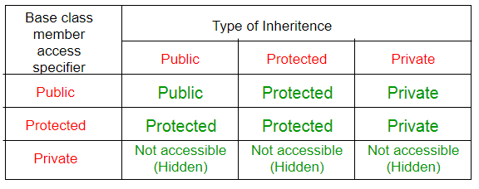
public, protected and private Inheritance

Slide 42
Multiple Inheritance
Employee
Student
Salaried
Graduate_Assistant

Slide 43
What is Multiple Inheritance?
If class A inherits from more than one class,
i.e., A → (B₁, B₂, ..., B_{n}), we speak of multiple inheritance.
This may introduce naming conflicts:
if at least two of its super_classes define properties (data members or member functions) with the same name.

Slide 44
//simple example showing multiple inheritance
class base1 {
public:
void funbase1(void) { cout<<"funbase1"; }
};
class base2 {
public:
void funbase2(void) { cout<<"funbase2"; }
};
class derived:public base1, public base2 {
public:
void funderived(void) { cout<<"funderived";}
};
void main(void) {
derived der;
der.funbase1();
der.funbase2();
der.funderived();
}

Slide 45
class base1 {
public:
base1() {
cout << "base 1 constructor" << endl;
}
~base1() {
cout << "base 1 destructor" << endl;
}
};
class base2 {
public:
base2() {
cout << "base 2 constructor" << endl;
}
~base2() {
cout << "base 2 destructor" << endl;
}
};
class derived :public base1, public base2 {
public:
derived() {
cout << "derived constructor" << endl;
}
~derived() {
cout << "derived destructor" << endl;
}
};
void main(void) {
derived der;
}
base 1 constructor
base 2 constructor
derived constructor
derived destructor
base 2 destructor
base 1 destructor

Slide 46
Example (ambiguity)
class A { public: void Foo() {} }
class B : public A {}
class C : public A {}
class D : public B, public C {}
D d;
d.Foo();
is this B's Foo() or C's Foo() ??

Slide 47
Solution (virtual inheritance)
class A {
public: void Foo() {}
}
class B : public virtual A {
}
class C : public virtual A {
}
class D : public B, public C {
}
D d;
d.Foo(); // no longer ambiguous

Slide 48
Another example
class PoweredDevice
{
public:
PoweredDevice(int nPower)
{
cout << "PoweredDevice: " << nPower << endl;
}
};

Slide 49
Another example
class Scanner: public PoweredDevice {
public:
Scanner(int nScanner, int nPower) : PoweredDevice(nPower)
{
cout << "Scanner: " << nScanner << endl;
}
};
class Printer: public PoweredDevice {
public:
Printer(int nPrinter, int nPower) : PoweredDevice(nPower)
{
cout << "Printer: " << nPrinter << endl;
}
};

Slide 50
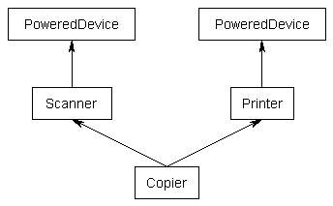
Another example
class Copier: public Scanner, public Printer
{
public:
Copier(int nScanner, int nPrinter, int nPower) : Scanner(nScanner, nPower), Printer(nPrinter, nPower)
{
}
};

Slide 51
Another example
int main()
{
Copier cCopier(1, 2, 3);
}
What should be the output?
PoweredDevice: 3
Scanner: 1
PoweredDevice: 3
Printer: 2

Slide 52
Multiple Inheritance
Employee
Student
Salaried
Graduate_Assistant

Slide 53
//Example (showing ambiguity)
typedef unsigned long ulong;
class Student {
ulong id;
unsigned age;
public:
unsigned GetAge() const { return age; }
ulong GetId() const { return id; }
void SetAge( unsigned n ) { age = n; }
void SetId( ulong n ) { id=n; }
};

Slide 54
class Employee {
public:
unsigned GetAge() const { return age; }
void SetAge( unsigned n ) { age = n; }
void SetId( ulong n) { id=n; }
ulong GetId(void) const { return id; }
private:
unsigned age;
ulong id;
};

Slide 55
class Salaried :public Employee {
float salary;
public:
float GetSalary() const { return salary; }
void SetSalary( float s ) { salary=s; }
};
class GradAssistant :public Student, public Salaried {
public:
void Display() const;
};
void GradAssistant::Display() const {
cout<<GetId()<<","<<GetSalary()<<","<<GetAge();//ambiguity
}

Slide 56
int main(void) {
GradAssistant ga;
ga.SetAge(20); //ambiguity
ga.SetId(15); //ambiguity
ga.Display(); //ambiguity inside display function
}//program will not compile and will generate errors

Slide 57
What is the solution?
Call functions explicitly by specifying name of class and using scope resolution operator to remove ambiguity:
Direct solution:
Student::SetAge() or Salaried::SetAge()
Virtual inheritance

Slide 58
//Example 2 corrected
typedef unsigned long ulong;
class Student {
ulong id;
unsigned age;
public:
unsigned GetAge() const { return age; }
ulong GetId() const { return id; }
void SetAge( unsigned n ) { age = n; }
void SetId( ulong n ) { id=n; }
};
class Employee {
public:
unsigned GetAge() const { return age; }
void SetAge( unsigned n ) { age = n; }
void SetId( ulong n) { id=n; }
ulong GetId(void) const { return id; }
private:
unsigned age;
ulong id;
};

Slide 59
class Salaried :public Employee {
float salary;
public:
float GetSalary() const { return salary; }
void SetSalary( float s ) { salary=s; }
};
class GradAssistant :public Student, public Salaried {
public:
void Display() const;
};
void GradAssistant::Display() const {
cout<<Employee::GetId()<<","<<Salaried::GetSalary()<<",“
<<Salaried::GetAge();
}
void main(void) {
GradAssistant ga;
ga.Employee::SetAge(20);
ga.Employee::SetId(15);
ga.Salaried::SetSalary(2000);
ga.Display();
}
//no ambiguity now, program will compile successfully now

Slide 60
Friend Functions and Classes
friend is a function or class that is not a member of a class, but has access to the private members of the class.
Classes keep a “list” of their friends, and only the external functions or classes whose names appear in the list are granted access
Friend function Syntax (in Class declaration):

Slide 61
Friend Functions - Examples
// Parent Class
class A {
protected:
int x;
public:
A() { x = 0; }
friend void show();
};
// Child Class
class B : public A {
private:
int y;
public:
B() { y = 0; }
};
void show()
{
B b;
cout << "The default value of A::x = " << b.x;
// Can't access private member declared in class 'B'
cout << "The default value of B::y = " << b.y;
}
int main()
{
show();
return 0;
}

Slide 62
Friend Classes
Not a good approach→ Declare a complete class as a friend:
All functions of the friend class can access all private members of the current class
Only a member function which needs access to private members must be allowed
Syntax:

Slide 63
#include <iostream>
using namespace std;
class First
{
// Declare a friend class
friend class Second;
public:
First() : a(0){}
void print()
{
cout << "The result is "<< a << endl;
}
private:
int a;
};
class Second
{
public:
void change( First& yclass, int x )
{
yclass.a = x;
}
};
int main()
{
First obj1;
Second obj2;
obj1.print();
obj2.change( obj1, 5 );
obj1.print();|
}
//Output
The result is 0
The result is 5

Slide 64
Part 3

Slide 65
Objectives
Polymorphism in C++
Pointers to derived classes
Introduction to virtual functions

Slide 66
Binding Process
Binding is the process to associate names with memory addresses.
Binding is done for each variable and functions.
For functions, it means that matching the call with the right function definition by the compiler.

Slide 67
Compile-time Binding (Static Binding)
Compile-time binding is to associate a function's name with the entry point (start memory address) of the function at compile time (also called early binding)
In C, only compile-time binding is provided
Start address if
sayHi() function

Slide 68
Run-time Binding (Dynamic Binding)
Run-time binding is to associate a function's name with the entry point (start memory address) of the function at run time (also called late binding)
C++ provides both compile-time and run-time bindings:
Non-Virtual functions (you have implemented so far) are binded at compile time.
Virtual functions (in C++) are binded at run-time.
Why virtual functions are used?
To implement Polymorphism

Slide 69
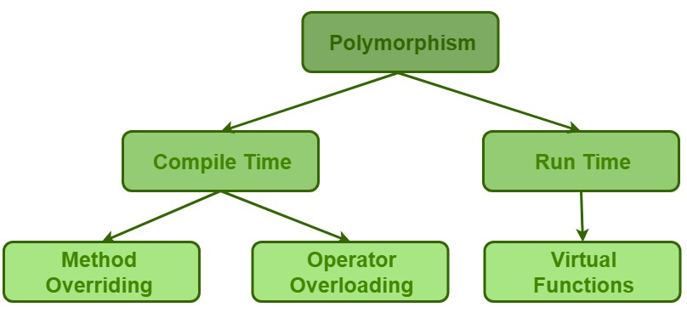
Polymorphism

Slide 70
Polymorphism
The Greek word polymorphism means one name, many forms.
Two types of Polymorphism in C++:
Static polymorphism: It can be achieved by using overloading. It is defined at compilation time (i.e., static binding).
Dynamic polymorphism: It can be implemented by using inheritance and implemented at runtime (i.e., Dynamic Binding) .

Slide 71
Static Polymorphism
//Function Overloading
class SomeClass
{
public:
// function with 1 int parameter
void func(int x){
cout << "value of x is " << x << endl;
}
// function with same name but 1 double parameter
void func(double x){
cout << "value of x is " << x << endl;
}
// function with same name and 2 int parameters
void func(int x, int y){
cout << "value of x and y is " << x << ", " << y << endl;
}
};
int main() {
SomeClass obj1;
// The first 'func' is called
obj1.func(7);
// The second 'func' is called
obj1.func(9.132);
// The third 'func' is called
obj1.func(85,64);
return 0;
}

Slide 72
Graphics Drawing Software, name these items?
shapes

Slide 73
Graphics Drawing Software Classes
Line
Properties:- X-Y Coordinates, Length, Color
Actions:- Draw Function, Change Color Function, Get Area Function.
Circle
Properties:- X-Y Coordinates, Radius, Color
Actions:- Draw Function, Change Color Function, Get Area Function.
Rectangle
Properties:- X-Y Coordinates, Width, Height, Color
Actions:- Draw Function, Change Color Function, Get Area Function.
Cylinder
Properties:- X-Y Coordinates, Radius, Height, Color
Actions:- Draw Function, Change Color Function, Get Area Function.
Triangle
Properties:- X-Y Coordinates, Length, Width, Color
Actions:- Draw Function, Change Color Function, Get Area Function.

Slide 74
class Line
{
protected:
int x,y;
public:
Line(int ,int );
void draw();
int GetArea (void);
};
Line::Line(int a,int b) {
x=a;
y=b;
}
void Line::draw( ) {
cout << “\n Line Drawing code”;
}
int Line::GetArea ( ) {
cout << “\nLine Area “; return 0;
}

Slide 75
class Circle: public Line {
protected:
int radius;
public:
Circle(int ,int, int );
void draw( );
int GetArea ( );
};
Circle::Circle(int a, int b, int c) : Line (a, b) {
radius = c;
}
void Circle::draw( ) {
cout << “Circle drawing code”;
}
int Circle::GetArea ( ) {
cout << “Circle area code”; return 0;
}

Slide 76
class Rectangle: public Line {
protected:
int Width, Height;
public:
Rectangle(int, int , int , int );
void draw(void);
int GetArea (void);
};
Rectangle::Rectangle(int a, int b, int c, int d) : Line (a, b ) {
Width = c; Height = d;
}
void Rectangle::draw() {
cout << “Rectangle drawing code”;
}
int Rectangle::GetArea () {
cout << “Rectangle area code”; return 0;
}

Slide 77
class Triangle: public Line {
protected:
int a_axis,b_axis,c_axis;
public:
Triangle(int, int , int);
void draw(void);
int GetArea (void);
};
Triangle::Triangle(int a, int b, int c) : Line (a, b ) {
a_axis= a; b_axis= b; c_axis=c;
}
void Triangle ::draw() {
cout << “Triangle drawing code”;
}
int Triangle ::GetArea () {
cout << “Triangle area code”; return 0;
}

Slide 78
int main ( )
{
Triangle t1 (3, 4, 5, 19 );
Circle c1 (3, 4, 5 );
Rectangle r1 ( 3, 4, 10 , 20 );
t1.draw ();
cout << “The area is “ << t1.GetArea ( );
c1.draw ();
cout << “The area is “ << c1.GetArea ();
r1.draw ();
cout << “The area is “ << r1.GetArea ();
return 0;
}
Shapes.cpp Demo

Slide 79
Polymorphism Scenario in C++
There is an inheritance hierarchy
The first class that defines a virtual function is the base class of the hierarchy that uses dynamic binding for that function name and signature.
Each of the derived classes in the hierarchy must have a virtual function with same name and signature.
There is a pointer of base class type that is used to invoke virtual functions of derived class.

Slide 80
Pointers to Derived Classes
C++ allows base class pointers to point to both base class object and also all derived class objects.
Let’s assume:
class Base { … };
class Derived : public Base { … };
Then, we can write:
Base *p1; Derived d_obj; p1 = &d_obj;
Base *p2 = new Derived;

Slide 81
Pointers to Derived Classes (contd.)
While it is allowed for a base class pointer to point to a derived object, the reverse is not true.
base b1;
derived *pd = &b1; // compiler error

Slide 82
Pointers to Derived Classes (contd.)
Access to members of a class object is determined by the type of the handle.
What is a Handle:
The item by which the members of an object are accessed:
An object name (i.e., variable, etc.)
A reference to an object
A pointer to an object

Slide 83
Pointers to Derived Classes (contd.)
Using a base class pointer (pointing to a derived class object) can access only those members of the derived object that were inherited from the base.
This is because the base pointer has knowledge only of the base class.
It knows nothing about the members added by the derived class.
DEMO: BasePtr.cpp
Notes:
A base class pointer can point to a derived class object, but we can only access base class member or virtual functions using the base class pointer because object slicing happens when a derived class object is assigned to a base class object. Additional attributes of a derived class object are sliced off to form the base class object.

Slide 84
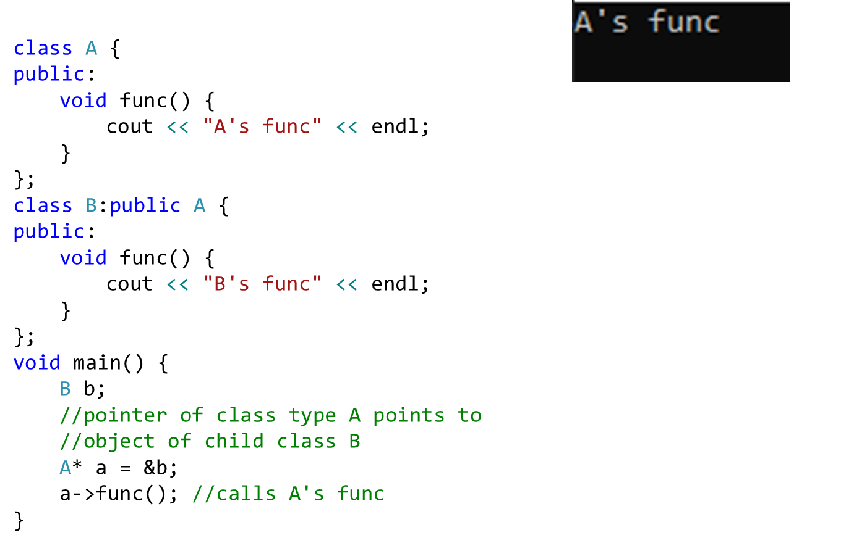
Pointer of Base Class

Slide 85
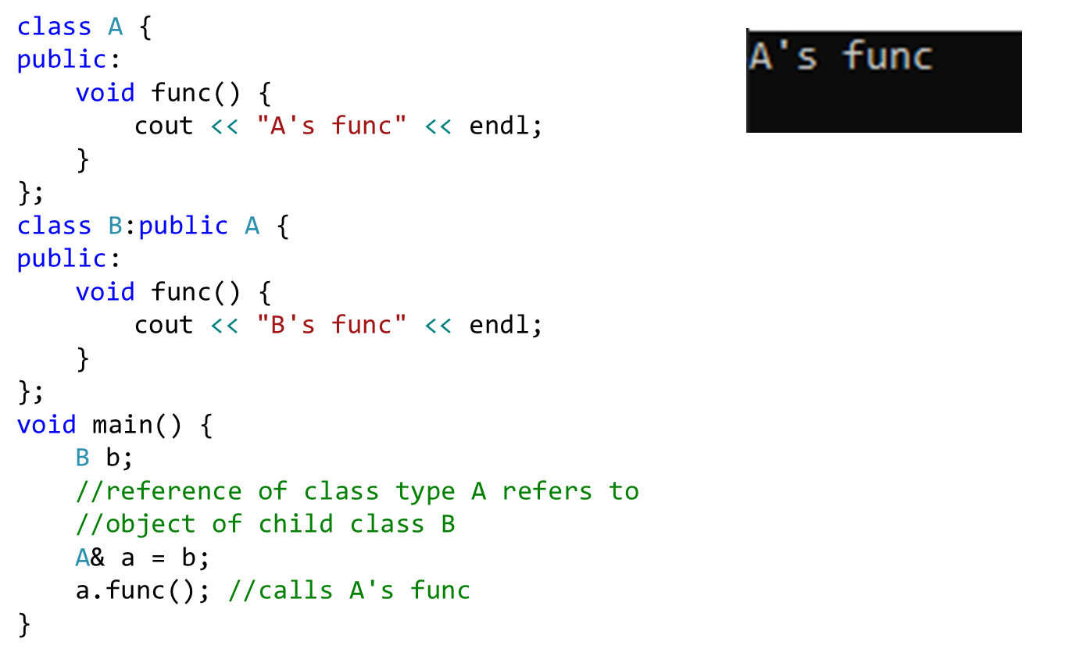
Reference of Base Class

Slide 86
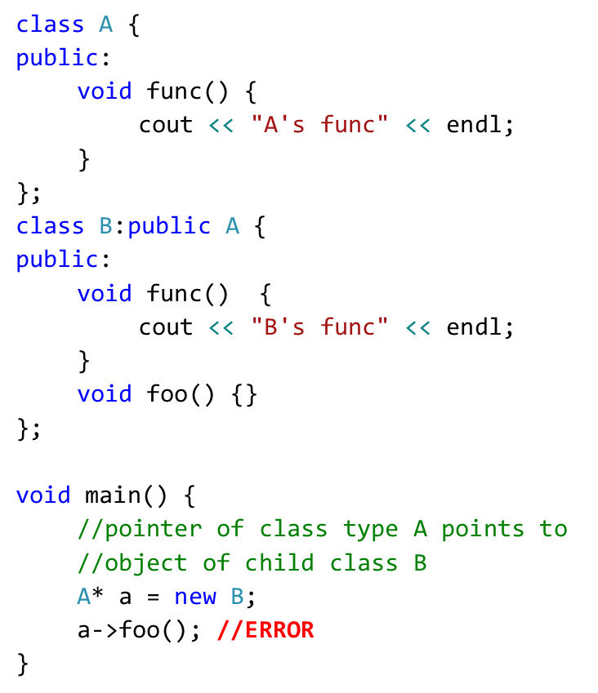
Pointer of Base Class
Parent class pointer/reference has NO KNOWLEDGE of child class functions

Slide 87
Summary – Based and Derived Class Pointers
Base-class pointer pointing to base-class object
Straightforward
Derived-class pointer pointing to derived-class object
Straightforward
Base-class pointer pointing to derived-class object
Safe
Can access non-virtual methods of only base-class
Can access virtual methods of derived class
Derived-class pointer pointing to base-class object
Compilation error

Slide 88
Pointers to Derived Classes
With the help of pointers to derived classes, we can create an array of base class objects, and that array can hold objects of different derived classes
Line *p[4];
p[0] = new Triangle (3, 4, 5, 19 );
p[1] = new Circle (3, 4, 5 );
p[2] = new Rectangle ( 3, 4, 10 , 20 );
p[3] = new Cylinder ( 3, 4, 5, 10 );
for ( int loop = 0; loop < 4; loop ++ )
{ p[loop]->draw ();
cout << “The area is “ << p[loop]->GetArea ( );
}

Slide 89
Virtual Functions based Shapes
DEMO: vShapes.cpp

Slide 90
Virtual function
Declaring a function virtual will make the compiler check the type of each object to search more specific version of the virtual function
To declare a function virtual, we use the Keyword virtual:
class Shape
{
public:
virtual void sayHi ()
{
cout <<“Just hi! \n”;
}
};

Slide 91
Virtual Functions
If the member function definition is outside the class, the keyword virtual must not be specified again.
Virtual functions can not be stand-alone or static functions.
A virtual function can be inherited from a base class by a derived class, like other class member functions.
Notes:
Virtual functions are invoked when you have a pointer or reference to an instance of a class. Static functions aren't tied to the instance of a class but they are tied to the class.

Slide 92
Virtual Functions
The virtualness of an operation is always inherited
if a function is virtual in the base class, it must be virtual in the derived class,
Even if the keyword “virtual” not specified (But always use the keyword in children classes for clarity.)
If no overridden function is provided, the virtual function of base class is used
Notes:
See inheritance5.h and pr15-03.cpp

Slide 93
Introduction to Virtual Functions
Terminology in C++:
redefine a method that uses static binding
override a method that uses dynamic binding (i.e., virtual functions)

Slide 94
Virtual Functions
To override a base class virtual function, the virtual function instance in derived class must match the base class virtual function exactly.
The overriding functions are virtual automatically. The use of keyword virtual is optional in derived classes.
Notes:
See inheritance5.h and pr15-03.cpp

Slide 95
Redefine Vs. Override
redefine (a method) is used for static binding (i.e., non-virtual functions):
Example: both base and derived classes contains a non-virtual function with same signature:
float getArea( ) { … } //A non-virtual function
override (a method) is used for dynamic binding (i.e., virtual functions):
Example: both base and derived classes contains a virtual function with the same signature:
virtual float getArea( ) { … } //A virtual function
Notes:
Often, we see very similar terms like “Redfine” and “Override”
Lets see the key differences…

Slide 96
Virtual Functions and override Keyword
The override keyword serves two purposes:
For Programmer: to indicate a virtual function that is overridden
For Compiler: to make sure same signature function exists in Base Class too (otherwise a Compilation Error ).
Notes:
See inheritance5.h and pr15-03.cpp

Slide 97
Example: Classes Using Virtual Functions
Class Hierarchy with Virtual Functions:
class Animal{
public:
virtual void id(){cout << "animal";}
};
class Cat : public Animal{
public:
virtual void id() override {cout << "cat";}
};
class Dog : public Animal{
public:
virtual void id() override {cout << "dog";}
};

Slide 98
Virtual Functions
If the member functions id( ) are declared virtual, then the code:
Animal *pA[] = {new Animal, new Dog, new Cat};
for(int k=0; k<3; k++)
pA[k]->id();
will print animal, dog, cat
Notes:
See inheritance5.h and pr15-03.cpp

Slide 99
Polymorphism Example (using Base Class’s Pointers and References)
DEMO: PolyExample2.cpp

Slide 100
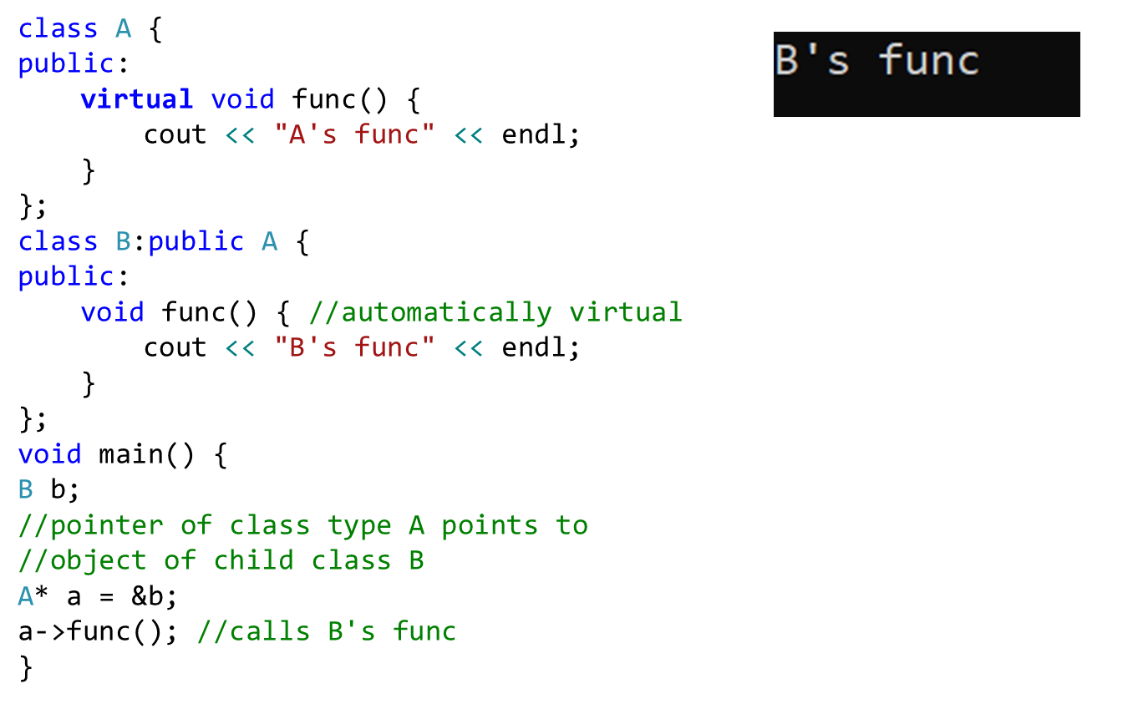
Virtual Functions

Slide 101
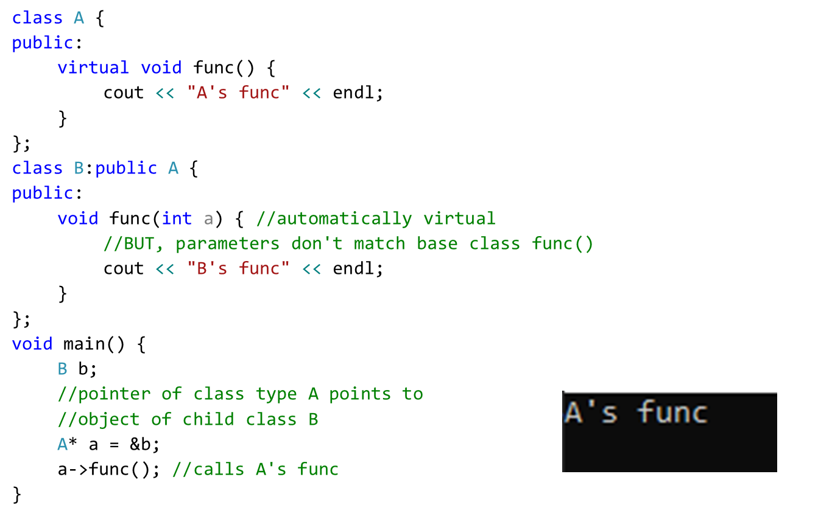
Virtual Functions
Overridden function parameters in derived class must be same as base class, otherwise base class func will be called

Slide 102
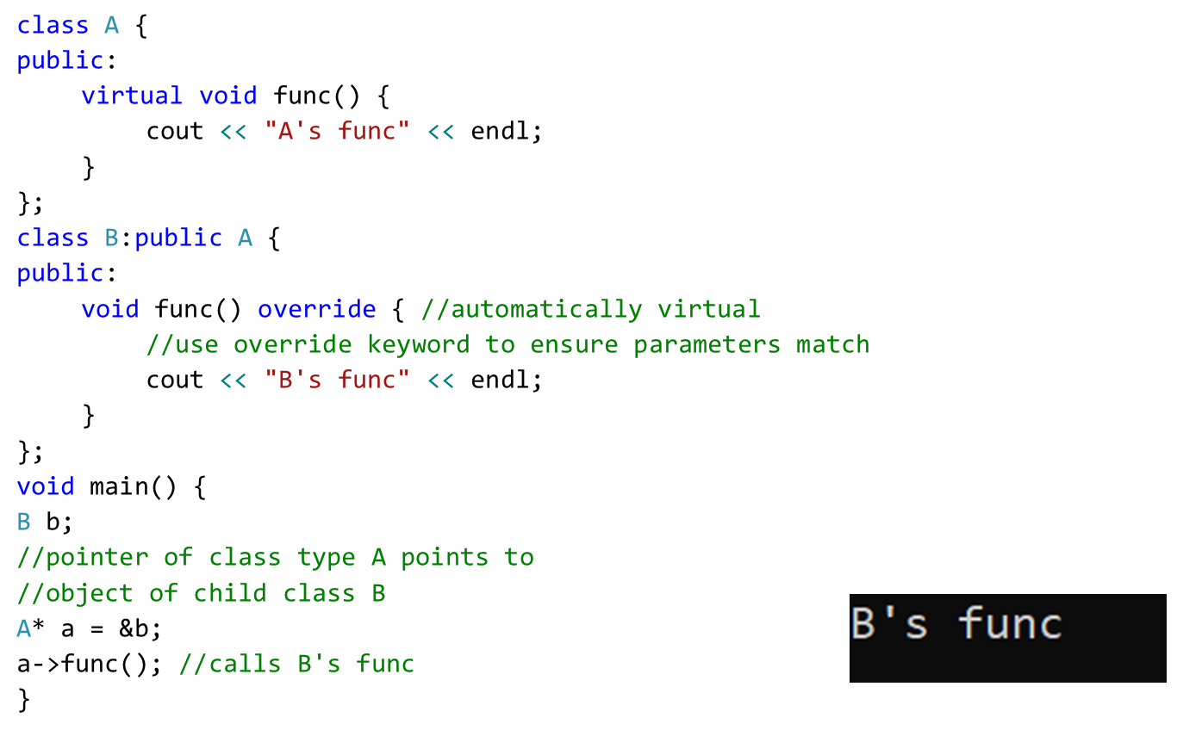
Virtual Functions
Override keyword

Slide 103
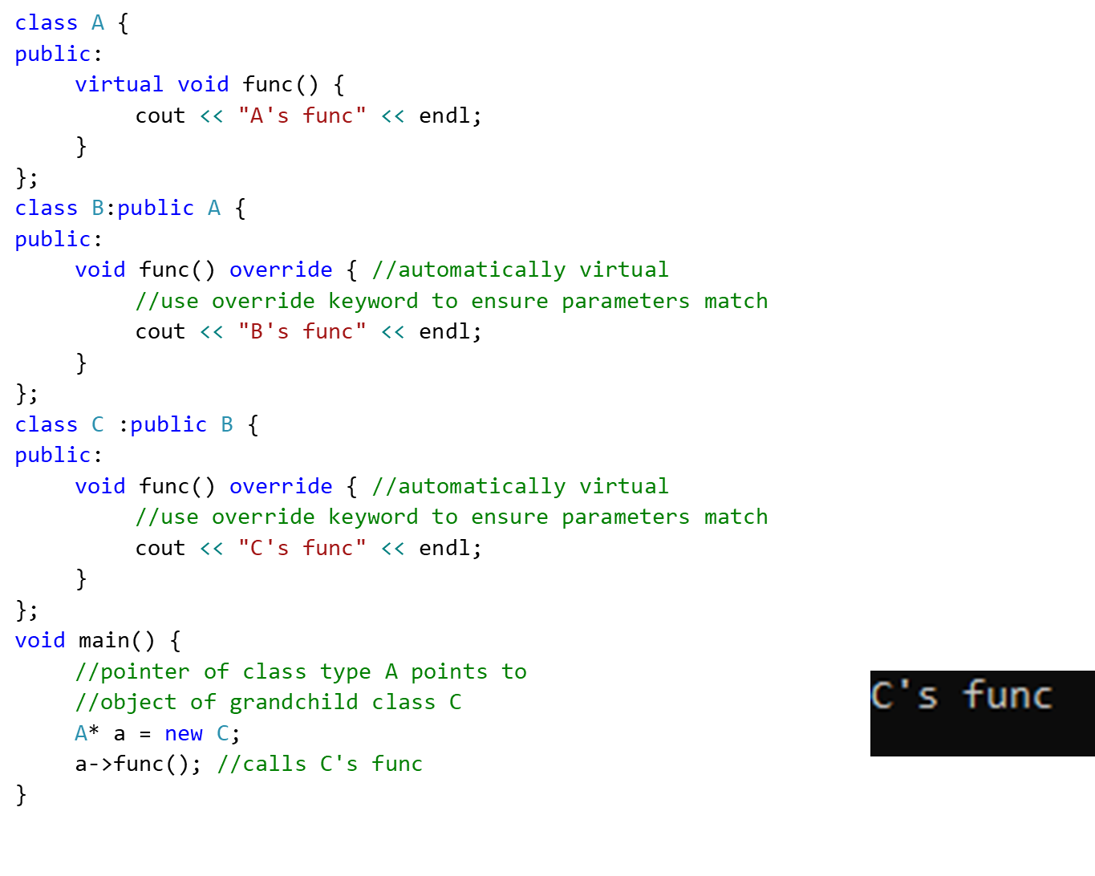
Virtual Function with multilevel inheritance

Slide 104
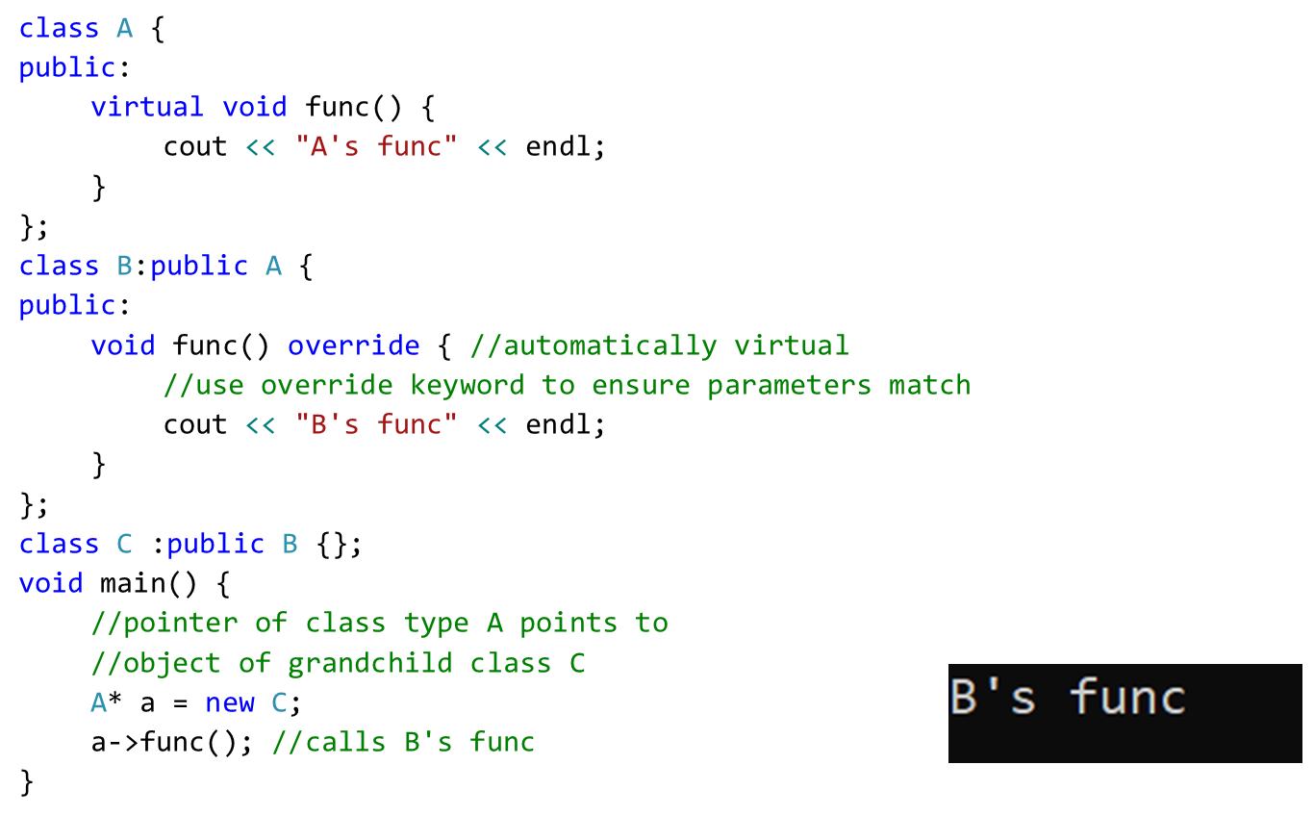
Virtual Function with multilevel inheritance
Class C does not override func(), if parent of class C has func(), that one is executed

Slide 105
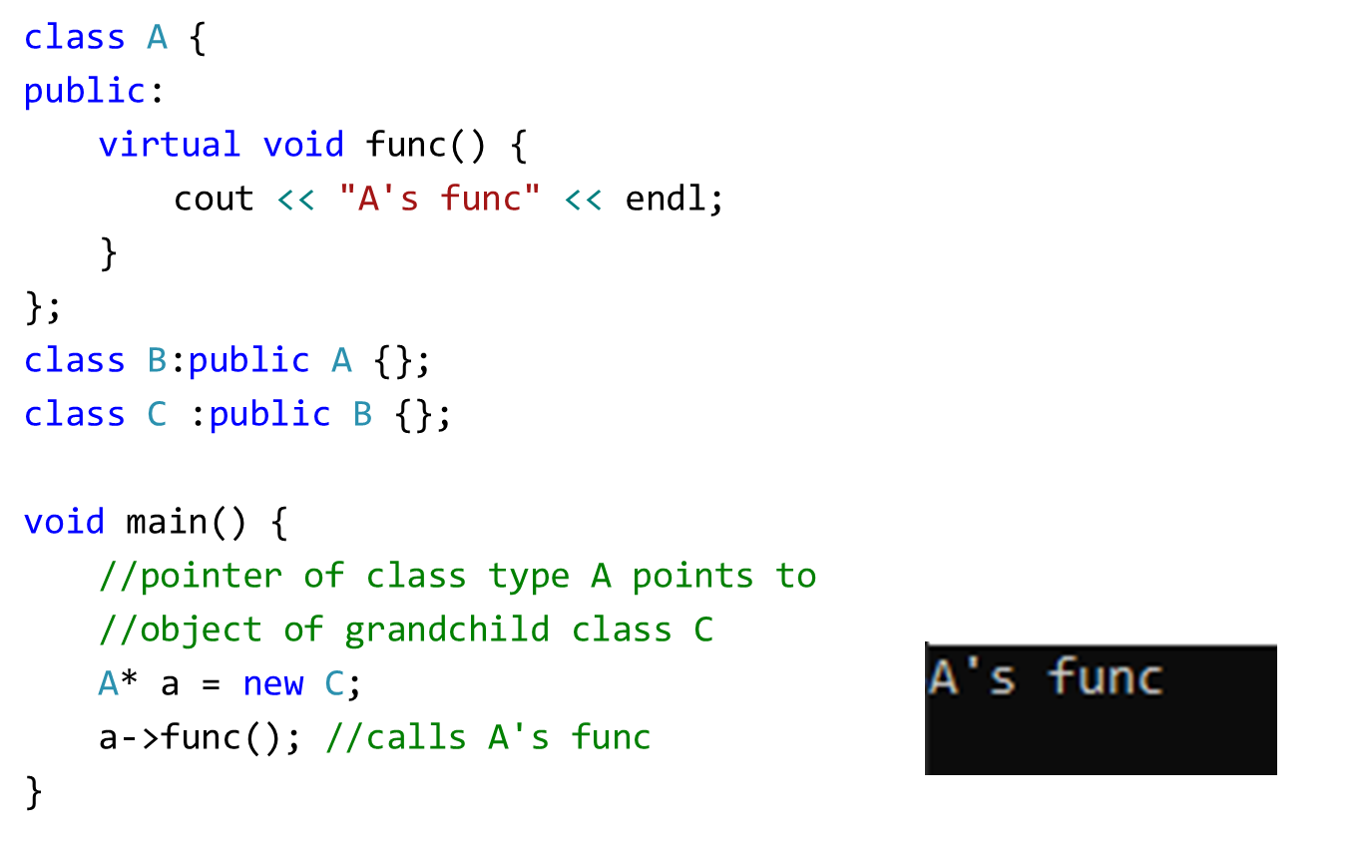
Virtual Function with multilevel inheritance
Class C does not override func(), class B also does not override func(),
A’s func is executed

Slide 106
with multiple inheritance
class A {
public:
void print() { //not virtual
cout << "Print class A" << endl;
}
~A() {
cout << "A's destructor" << endl;
}
};
class B {
public:
virtual void print() {
cout << "Print class B" << endl;
}
~B() {
cout << "B's destructor" << endl;
}
};
class C :public B,public A {
public:
void print() {
cout << "Print class C" << endl;
}
~C() {
cout << "C's destructor" << endl;
}
};
int main() {
B *b=new C;
A* a=new C;
b->print();
a->print();
return 0;
}
Output:
Print class C
Print class A

Slide 107
Virtual Constructor/Destructors
Constructor cannot be virtual, because when a constructor is being executed there is no virtual table (for that object) in the memory, (i.e., no virtual pointer defined yet).
Destructors can be virtual (should be made virtual)
A virtual Destructor, ensures that the derived class destructor is called when a base class pointer is used. (deleting memory allocation in derived class first …)
virtual ~Shape();

Slide 108
Virtual Destructors (contd.)
class base {
public:
~base() {
cout << “destructing base\n”;
}
};
class derived : public base {
public:
~derived() {
cout << “destructing derived\n”;
}
};
int main()
{
base *p = new derived;
delete p;
return 0;
}
Output:
destructing base
Using non-virtual destructor

Slide 109
Virtual Destructors (contd.)
class base {
public:
virtual ~base() {
cout << “destructing base\n”;
}
};
class derived : public base {
public:
~derived() {
cout << “destructing derived\n”;
}
};
int main()
{
base *p = new derived;
delete p;
return 0;
}
Output:
destructing derived
destructing base
Using virtual destructor

Slide 110
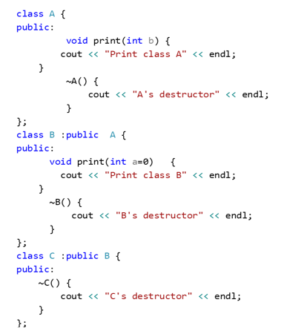
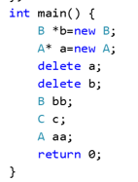
Destructors

Slide 111
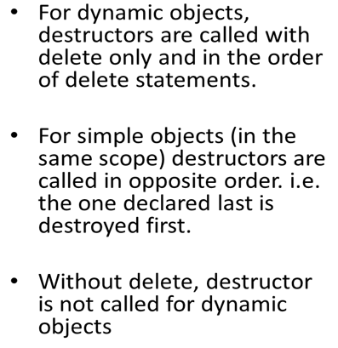
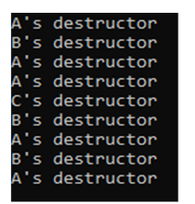
Contd.

Slide 112
Part 3 - Contents
Classes in C++
Concrete and Abstract Classes
Pure Virtual Function
Usage of Pure-Virtual function and Abstract Classes
Example Code…
Notes:
In this lecture, we will cover the following topics:
Concrete Classes
Abstract Classes
Pure Virtual Function
Abstract Classes
A Complete Example Related to Polymorphism

Slide 113
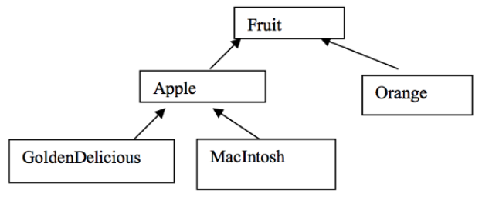
Classes in C++
It is true that all objects are represented by a class, the converse is not true.
All classes do not necessarily represent objects:
In C++, we can classify the Classes:
Concrete Classes
Abstract Classes

Slide 114
Concrete Classes
Concrete Classes: used to instantiate objects
Must provide implementation for every member function they define

Slide 115
Abstract Classes
Classes from which it is never intended to instantiate any objects (Reasons?):
Incomplete—derived classes must define the “missing pieces”
Too generic to define real objects.
Normally used as base classes and called abstract base classes
It is a common public interface for the entire class hierarchy

Slide 116
Pure virtual Functions
A class is made abstract by declaring one or more of its virtual functions to be “pure”
I.e., by placing "= 0" in its declaration
Example:
virtual void draw() const = 0;
"= 0" is known as a pure specifier.
Tells compiler that there is no implementation.

Slide 117
Pure virtual Functions (cont.)
Every concrete derived class must override all base-class pure virtual functions
with concrete implementations
If even one pure virtual function is not overridden
the derived-class will also be abstract
Compiler will refuse to create any objects of the class
Cannot call a constructor
However, we can create Pointers and references of abstract classes:
To point or refer the derived class objects

Slide 118
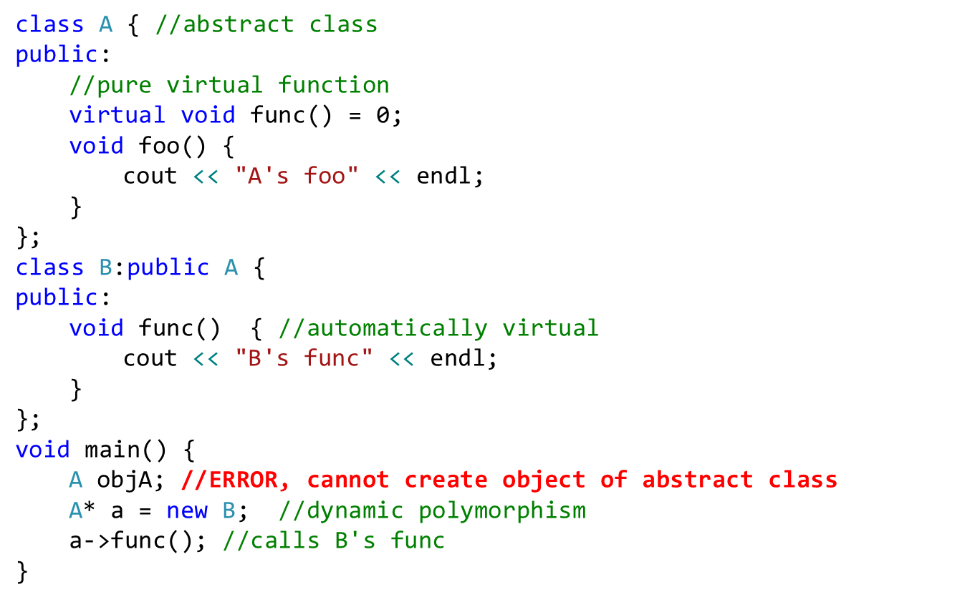
Pure virtual Functions (cont.)
A class with even one pure virtual function is an abstract class

Slide 119
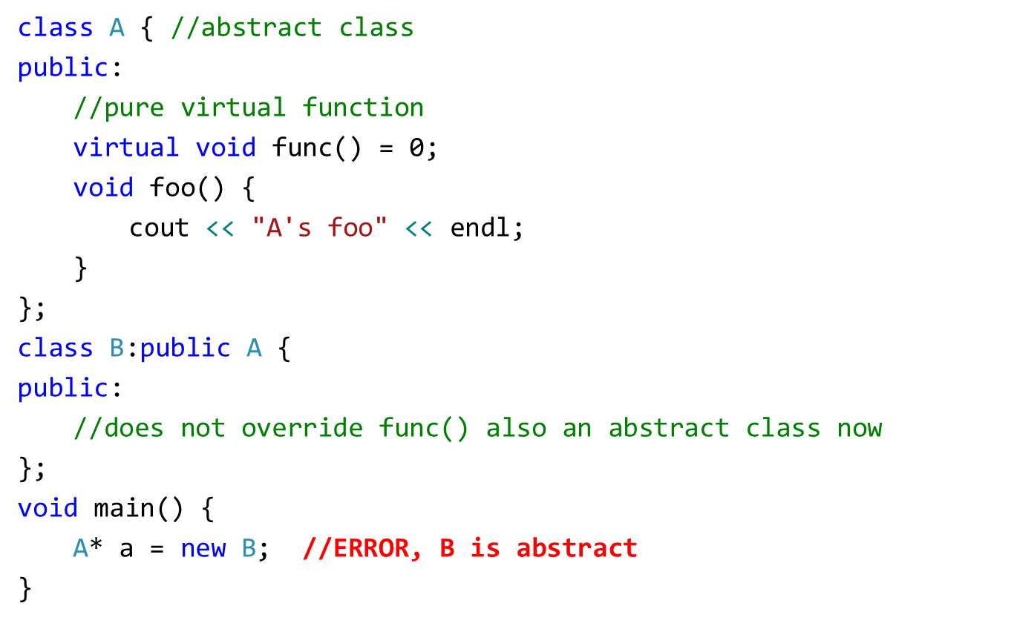
Pure virtual Functions (cont.)

Slide 120
Purpose
When it does not make sense for base class to have an implementation of a function
Software design requires all concrete derived classes to implement the function
Themselves (to meet customized needs)

Slide 121
Why Do we Want to do This?
To define a common public interface in a class hierarchy
To create Abstraction Framework (in our software system)
It is a core feature of Object-Oriented Design
Simplifies development of big software systems
Enables code re-use, Readable, maintainable, adaptable code

Slide 122
Case Study: Payroll System Using Polymorphism
Create a payroll program
Use virtual functions and polymorphism
Problem statement
4 types of employees, paid weekly:
Salaried (fixed salary, no matter the hours)
Hourly workers
Commission (paid percentage of sales)
Base-plus-commission (base salary + percentage of sales)

Slide 123
Case Study: Payroll System Using Polymorphism
Base class Employee:
Pure virtual function earnings (returns pay)
Pure virtual because need to know employee type
Cannot calculate for generic employee
Other classes derive from Employee
Employee
SalariedEmployee
CommissionEmployee
HourlyEmployee
BasePlusCommissionEmployee

Slide 124
Employee Example
class Employee {
public:
Employee(const char *, const char *);
~Employee();
char *getFirstName() const;
char *getLastName() const;
// Pure virtual functions make Employee abstract base class.
virtual float earnings() const = 0; // pure virtual
virtual void print() const = 0; // pure virtual
protected:
char *firstName;
char *lastName;
};
DEMO:
Payroll.cpp

Slide 125
Employee::Employee(const char *first, const char *last)
{
firstName = new char[ strlen(first) + 1 ];
strcpy(firstName, first);
lastName = new char[ strlen(last) + 1 ];
strcpy(lastName, last);
}
// Destructor deallocates dynamically allocated memory
Employee::~Employee() {
delete [] firstName; delete [] lastName;
}
//Return a pointer to the first name
char *Employee::getFirstName() const {
return firstName; // caller must delete memory
}
char *Employee::getLastName() const {
return lastName; // caller must delete memory
}

Slide 126
class SalariedEmployee: public Employee {
public:
SalariedEmployee(const char *, const char *, float = 0.0);
void setWeeklySalary(float);
virtual float earnings() const;
virtual void print() const;
private:
float weeklySalary;
};

Slide 127
// Constructor function for class
SalariedEmployee:: SalariedEmployee(const char *first,
const char *last, float s)
: Employee(first, last) // call base-class constructor
{ weeklySalary = s > 0 ? s : 0; }
// Set the SalariedEmployee’s salary
void SalariedEmployee::setWeeklySalary(float s)
{ weeklySalary = s > 0 ? s : 0; }
// Get the SalariedEmployee’s pay
float SalariedEmployee::earnings() const { return weeklySalary; }
// Print the SalariedEmployee’s name
void SalariedEmployee::print() const
{
cout << endl << " Salaried Employee: " << getFirstName()
<< ' ' << getLastName();
}

Slide 128
class CommissionWorker : public Employee {
public:
CommissionWorker(const char *, const char *, float = 0.0, unsigned = 0);
void setCommission(float);
void setQuantity(unsigned);
virtual float earnings() const;
virtual void print() const;
private:
float commission; // amount per item sold
unsigned quantity; // total items sold for week
};

Slide 129
CommissionWorker::CommissionWorker(const char *first, const char *last, float c, unsigned q)
: Employee(first, last) // call base-class constructor
{
commission = c > 0 ? c : 0;
quantity = q > 0 ? q : 0;
}
void CommissionWorker::setCommission(float c)
{ commission = c > 0 ? c : 0; }
void CommissionWorker::setQuantity(unsigned q)
{ quantity = q > 0 ? q : 0; }
float CommissionWorker::earnings() const
{ return commission * quantity; }
void CommissionWorker::print() const
{
cout << endl << "Commission worker: " << getFirstName()
<< ' ' << getLastName();
}

Slide 130
class HourlyWorker : public Employee {
public:
HourlyWorker(const char *, const char *,
float = 0.0, float = 0.0);
void setWage(float);
void setHours(float);
virtual float earnings() const;
virtual void print() const;
private:
float wage; // wage per hour
float hours; // hours worked for week
};

Slide 131
HourlyWorker::HourlyWorker(const char *first, const char *last float w, float h)
: Employee(first, last) // call base-class constructor
{
wage = w > 0 ? w : 0;
hours = h >= 0 && h < 168 ? h : 0;
}
void HourlyWorker::setWage(float w) { wage = w > 0 ? w : 0; }
// Set the hours worked
void HourlyWorker::setHours(float h)
{ hours = h >= 0 && h < 168 ? h : 0; }
// Get the HourlyWorker's pay
float HourlyWorker::earnings() const { return wage * hours; }
// Print the HourlyWorker's name
void HourlyWorker::print() const
{
cout << endl << " Hourly worker: " << getFirstName()
<< ' ' << getLastName();
}

Slide 132
class BasePlusCommissionEmployee:public CommissionWorker
{
private:
float baseSalary;
public:
BasePlusCommissionEmployee(const char* , const char* , float =0.0, unsigned =0,float =0.0);
void setBaseSalary(float sal) {
baseSalary = sal;
}
float getBaseSalary(void) const {
return baseSalary;
}
void print() const;
float earnings() const;
};

Slide 133
BasePlusCommissionEmployee::BasePlusCommissionEmployee(const char* first, const char* last, float c,
unsigned q,float sal)
:CommissionWorker(first,last,c,q)
{
baseSalary=(sal);
}
void BasePlusCommissionEmployee::print() const
{
cout << "\nbase-salaried commission employee: ";
CommissionWorker::print(); // code reuse
} // end function print
float BasePlusCommissionEmployee::earnings() const
{
return getBaseSalary() + CommissionWorker::earnings();
} // end function earnings

Slide 134
void main(void)
{
Employee *ptr; // base-class pointer
SalariedEmployee b(“Nauman", "Sarwar", 800.00);
ptr = &b; // base-class pointer to derived-class object
ptr->print(); // dynamic binding
cout << " earned $" << ptr->earnings(); // dynamic binding
b.print(); // static binding
cout << " earned $" << b.earnings(); // static binding
CommissionWorker c(“Qasim", “Ali", 3.0, 150);
ptr = &c; // base-class pointer to derived-class object
ptr->print(); // dynamic binding
cout << " earned $" << ptr->earnings(); // dynamic binding
c.print(); // static binding
cout << " earned $" << c.earnings(); // static binding

Slide 135
BasePlusCommissionEmployee p("Mehshan", "Mustafa", 2.5, 200, 1000.0);
ptr = &p; // base-class pointer to derived-class object
ptr->print(); // dynamic binding
cout << " earned $" << ptr->earnings(); // dynamic binding
p.print(); // static binding
cout << " earned $" << p.earnings(); // static binding
HourlyWorker h(“Samer", “Tufail", 13.75, 40);
ptr = &h; // base-class pointer to derived-class object
ptr->print(); // dynamic binding
cout << " earned $" << ptr->earnings(); // dynamic binding
h.print(); // static binding
cout << " earned $" << h.earnings(); // static binding
cout << endl;
return 0;
}

